Slide 1
Smart shopping list
Team: Filip, Amélie, Adam, Udeshkumar, Stefan
Internet of things
Smartphone Application
Smart refigerator generates data
App analyzes the data and presents it adequately
7 months with 5 members

Slide 2
Business Case
Summary
  Description of the app
Background
  Smart objects
  Generate new data
  Data analysis
  Smartphone app presents data

Slide 3
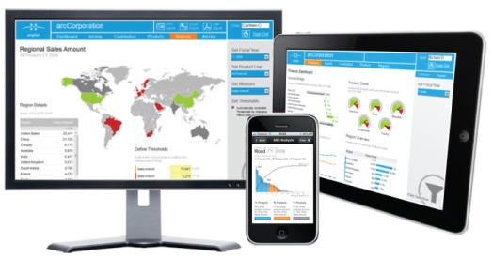
Business Case
Business intelligence dashboards

Slide 4
Business Case
Results
  Improvements and benefits
    User perspective
    Company perspective
potential increase the sales of the refrigerator.
transform from traditional household appliances
company to smart household appliances.
potentials of improvement of customer relationship based on customer data

Slide 5
Business Case
Conclusion
Every house needs one smart refrigerator and the smart shop list app.

